Slide 2
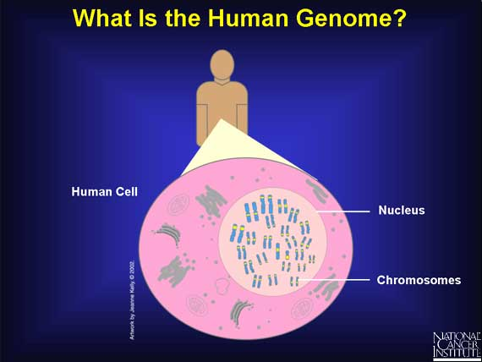

Slide 3
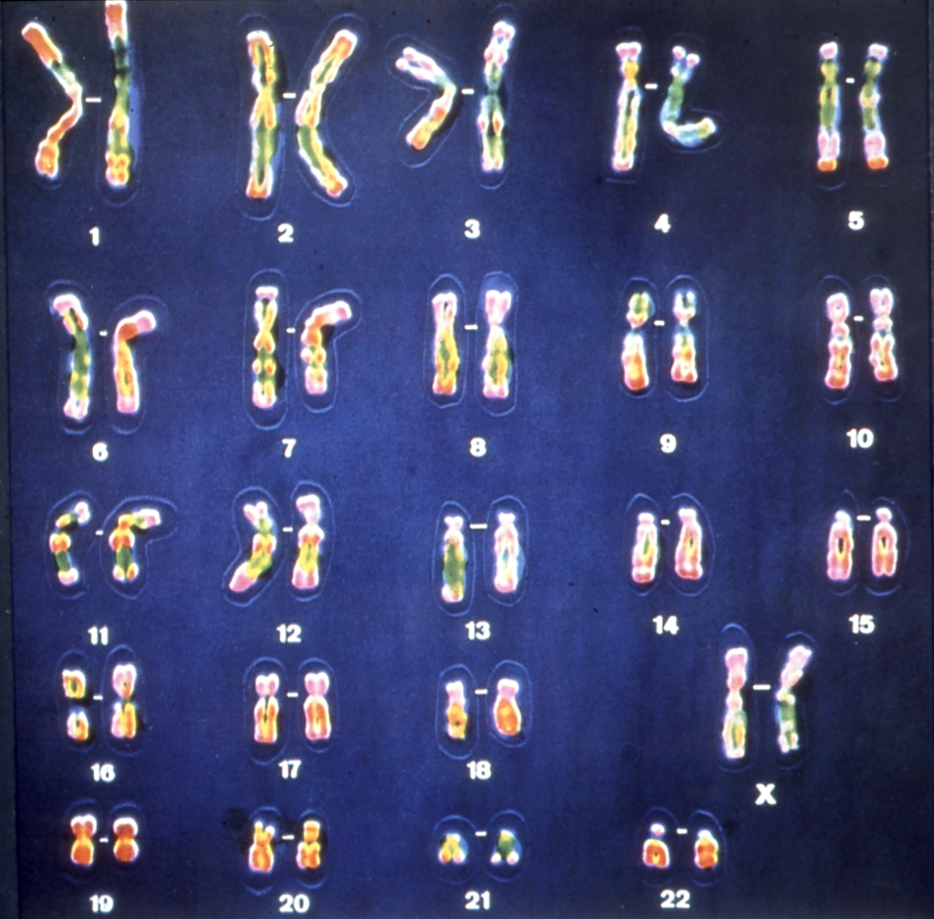

Slide 4
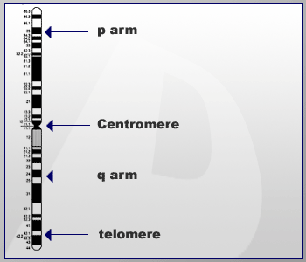
Notes:
P= short arm or petite
Q is the longer arm and comes after letter p in the alphabet

Slide 5
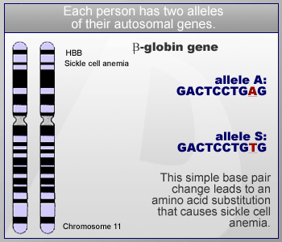

Slide 6

Biology 101
DNA: elegant simplicity
  A molecule consisting of two strands that wrap around each other to form a “twisted ladder” shape, with the sides made of sugar and phosphate, with rungs made of nitrogen-containing chemicals called bases
  Four (and only four) different bases are present
  The order of the bases provides the genetic information

Slide 7
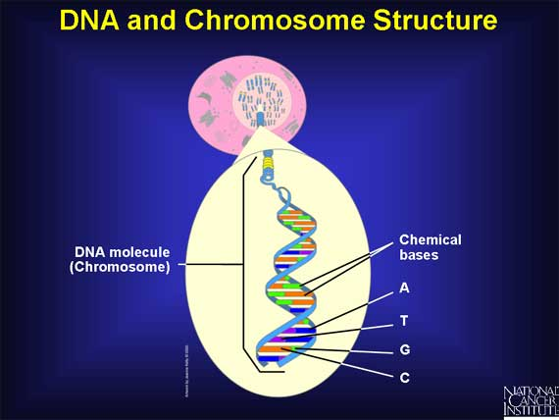
Notes:
Four Nucleotide Bases: Adenine, cytosine, guanine, and thymine

Slide 8
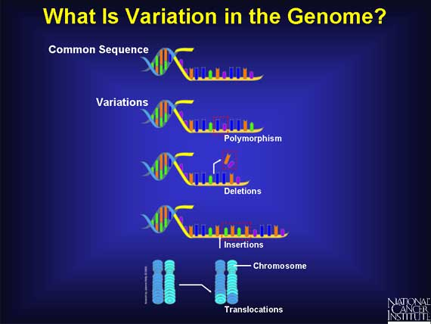
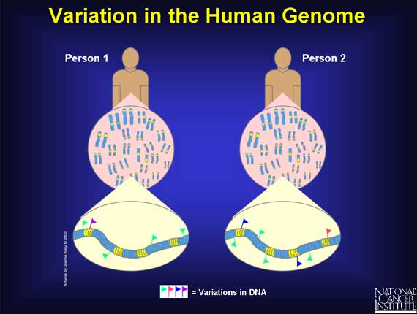

Slide 9
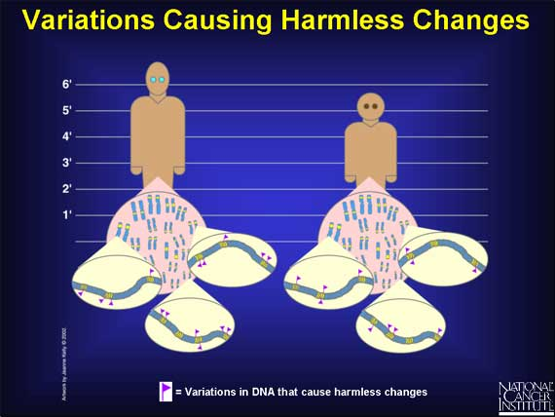

Slide 10
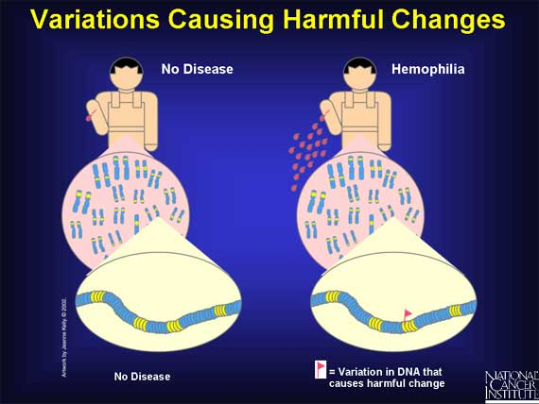

Slide 11
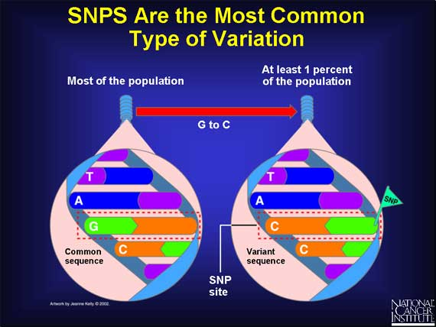

Slide 12
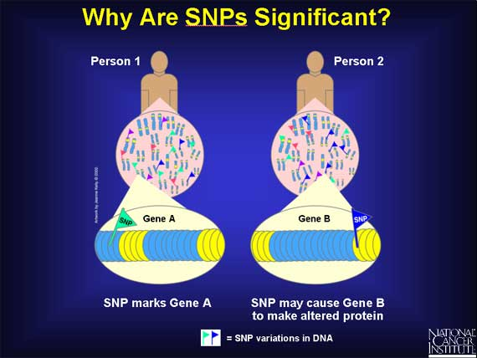

Slide 13
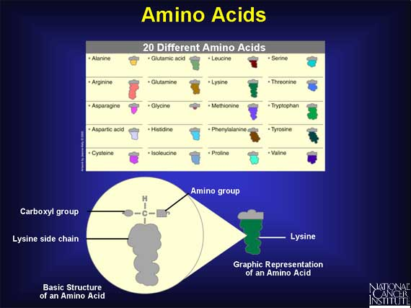

Slide 14
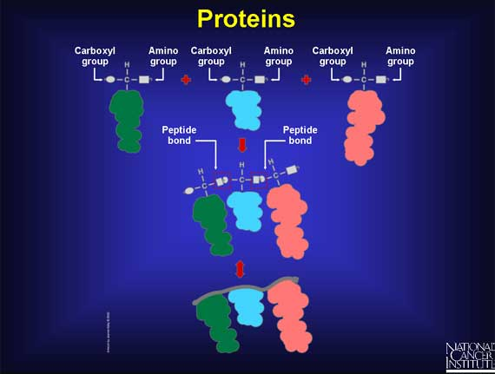

Slide 15
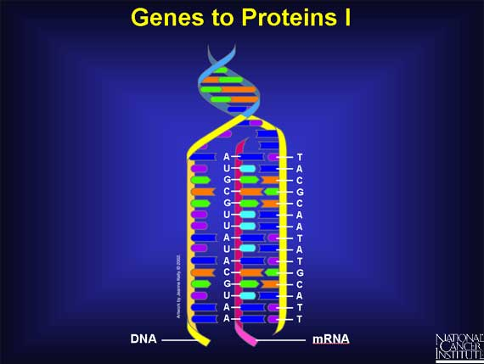
Transcription
Non-Synonymous SNPS

Slide 16
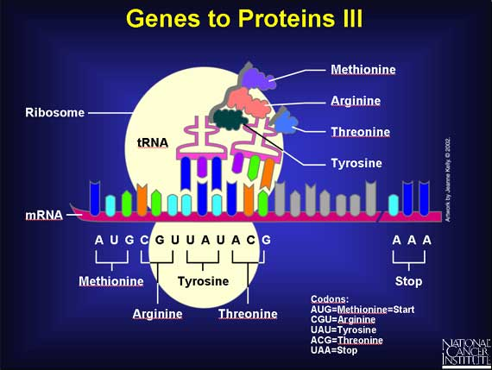
Translation

Slide 17
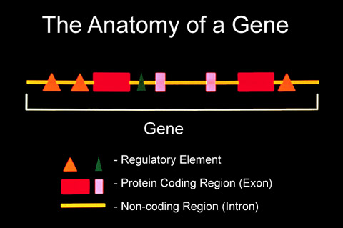
Notes:
Strand orientation is 5’ to 3’ or vice versa

Slide 18
Allele: One of the alternative versions of a gene at a specific locus on a chromosome
Additive model: Mechanism of quantitative inheritance such that the combined effects of alleles are equal to the sum of their individual effects
First vs. Second Generation Sequencing: !st uses lab based technique- called “sanger sequencing” 2nd or “next gen” is automated using “sequencers” which automate reaction needed for base pair reads
Exome sequencing: a technique for sequencing all of the protein-coding genes in a genome
Gene expression: the translation of information encoded in a gene into protein or RNA structures
DNA methylation: deactivates genes and regulates their tissue-specific transcription levels

Slide 19
Using the HAPMAP Data
How useful Is HAPMAP to study haplotype variation in diverse human population?
What can we learn about human history?

Slide 20
Methods
Survey SNP variation in 927 unrelated individual from 52 populations in the HGDP
Genotyped 3,024 SNPs from 36 genomic regions – each region spanned 330kb
Results:
Haplotype structure is greatest for nearby populations, especially from the same continent
Steady decline in haplotype diversity with distance from Africa

Slide 21
International HapMap
Empirical genotype data from > 3 million SNPs in a limited samples of 270 individuals from 4 populations
  European origin from Utah
  Yoruba – West African
  Han Chinese
  Japanese

Slide 22
Recombination rates across populations
High levels of LD produced low estimates of population recombination
Recombination hotspots lead to localized peaks of high population recombination
  LD is strong and diversity very low in American populations and Oceania (East Asia, Papuan)
  African- Yoruba have lowest LD

Slide 23
World Wide Portability of the HAPMAP
83% of common haplotypes are also common in the most similar HapMap populations
Most population in HDGP have extensive haplotype sharing with the at least one HapMap population
Haplotype sharing is highest in Han Chinese and Japanese
Lowest for Hunter gather Africans with Yoruba of Hap Map
Portability of Hap Map is highest for high LD populations and low for low LD populations –i.e. African are hardest and Native American are easiest
Low LD populations will continue to require increased density of tagged SNPs to achieve same proportion of variation tagged in higher LD populations
Conrad et al Nature Genetics 2006

Slide 24
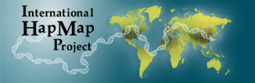
Published “human genome sequence” is based on a few donors
1 in 1200 nucleotides in the genome differ among individuals
That variability is key to understanding variability in disease susceptibility and outcomes
SNP = single nucleotide polymorphism
As of 2007, 3.1 million SNPs genotyped in 270 individuals from 4 geographically diverse populations
SNPs travel in patterns or “haplotypes”

Slide 25
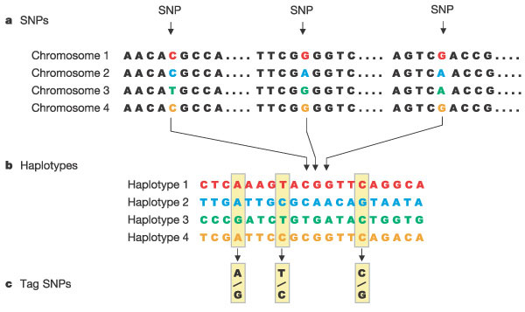
The International HapMap Consortium.
Nature. 2003;426:789-796. Reproduced with permission.
“Genetic variants that are near each other tend to be inherited together. For example, all of the people who have an A rather than a G at a particular location in a chromosome can have identical genetic variants at other SNPs in the chromosomal region surrounding the A. These regions of linked variants are known as haplotypes (Figure). “

