Slide 1
Gene-Diet Interations
HRM728
Russell de Souza, RD, ScD
Assistant Professor
Population Genomics Program
Clinical Epidemiology & Biostatistics

Slide 2
A few words about the readings…
Just to expose you to different gene-diet interaction study designs
  Don’t panic if you haven’t read them!
  I will be discussing them in class today, so anything you have read will help, but not having read anything won’t hurt you
I’ll spend a fair bit of time on “thinking” about how to study; less time on details
We’ll review study designs and epidemiology terminology as I go through examples…

Slide 3
Today’s objectives
Does diet cause disease?
Why study gene-diet interactions?
What do we mean by interaction?
Methodological approaches to studying gene-diet interaction
Public Health implications

Slide 4
Today’s objectives
Does diet cause disease?
Why study gene-diet interactions?
What do we mean by interaction?
Methodological approaches to studying gene-diet interaction
Public Health implications

Slide 5
Does diet cause disease?
Disease
Diet

Slide 6
The road is not smooth!
Metabolic
differences
Body
Size
Disease
Physical
activity
Diet
Cooking method
Other
dietary
components
Genetic
factors

Slide 7
One diet to fit all?
*not exhaustive!
Body size
  Protein recommendations based on body size; vitamin C recommendations are not
Physical activity
  Does a high-carbohydrate diet have the same effects on HDL-C and triglycerides in a marathon runner as it does in someone who is inactive and obese?
Genetic factors
  Genetic mutations (ALDH2) favour alcohol→acetaldehyde

Slide 8
One diet to fit all?
*not exhaustive!
Metabolic differences
  Ability to digest lactose diminishes with age
Other dietary components
  Polyunsaturated:saturated fat in the diet

Slide 9
Does diet cause disease?
Disease
Diet

Slide 10
Diet
Essential nutrients (vitamins, minerals, amino acids, etc.)
Major energy sources (carbohydrates, proteins, fats, alcohol)
Additives (colouring agents, preservatives, emulsifiers)
Microbial toxins (aflatoxin, botulin)
Contaminants (lead, PCBs)
Chemicals formed during cooking (acrylamide, trans fats)
Natural toxins (plants’ response to reduced pesticides)
Other compounds (caffeine)
Willett, 1998

Slide 11
Genes
A single SNP
Multiple SNPs
Epigenetic modification
Willett, 1998

Slide 12
Today’s objectives
Does diet cause disease?
Why study gene-diet interactions?
What do we mean by interaction?
Methodological approaches to studying gene-diet interaction
Public Health implications

Slide 13
Concept of Heritability
Proportion of a traits total variance that is attributable to genetic factors in a particular population
Trait: Quantitative trait or continuous trait – i.e. height
“Attributable to” ≠ “caused by”
If everyone in the population were homozygous or everyone in the population had the same environmental exposure – the factors would not play a role in the “variance” in a trait
Heritability = zero

Slide 14
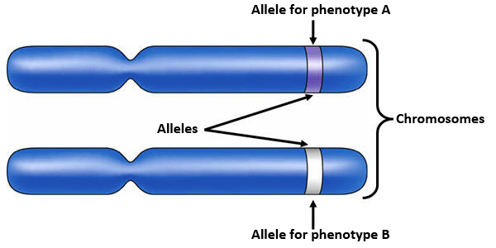
Allele and Genotype Frequencies
Two alleles at each genetic locus
If the two alleles are the same, individual is homozygous
If the two alleles are different, individual is heterozygous

Slide 15
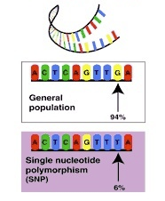
Polymorphism
A genetic locus than can exist in different forms
Insertion, deletion SNP, tandem repeat, copy number variant
Created by random mutations
May have no functional consequence (>1 codon for an amino acid)

Slide 16
Nutrigenomics
the application of genomics in nutrition research, enabling associations to be made between specific nutrients and genetic factors, e.g. the way in which food or food ingredients influence gene expression…
Nutrigenomics should facilitate greater understanding of how nutrition affects metabolic pathways and how this process goes awry in diet-related diseases
Chadwick R. (2004) Proceedings of the Nutrition Society 63:161-166.

Slide 17
Nutrigenetics
the study of individual differences at the genetic level influencing response to diet. These individual differences may be at the level of single nucleotide polymorphisms rather than at the gene level…It is envisaged that nutrigenetics may lead to individualized dietary advice
Chadwick R. (2004) Proceedings of the Nutrition Society 63:161-166.

Slide 18
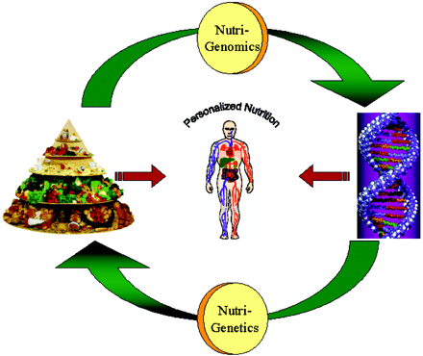
Mutch D, et al. (2005) FASEB Journal 19:1602-1616.

Slide 19
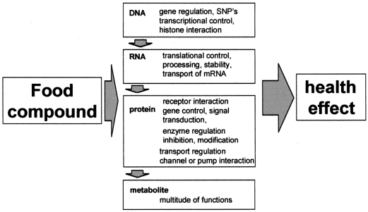
van Ommen B. (2004) Nutrition 20:4-8.

Slide 20
Examples
Metabolism of nutrients may vary by genotype
Single Gene Disorders
  PKU (can’t metabolize phenylalanine—limit protein)
  Lactose intolerance (can’t digest lactose—give lactase)
Complex Disorders
  There are genes associated with complex conditions (e.g. T2DM, heart disease)
  Nutritional environment can modify expression of genes

Slide 21
Variability in LDL-C response following Diet Therapy
Men
Women

Slide 22
LDL-C Response to a Therapeutic Diet by APOE allele
b
b
b
b
b
a
Lopez-Miranda et al. J Lipid Res. 1994;35:1965-75.

Slide 23
Gene-Environment Interactions
Gene effect: The presence of a gene (SNP) influences risk of disease
Environment effect: Exposure to an environmental factor influences risk of disease
Gene x Environment Interaction:
  The effect of genotype on disease risk depends on exposure to an environmental factor
  The effect of exposure to an environmental factor on disease risk depends on genotype

Slide 24
Gene-Environment Interactions

Slide 25
Presence of Gene-Environment Interactions
Familial aggregation of disease
  Greater prevalence of disease in first degree relatives (vs. spouses) suggests more than “shared environment”
  Stronger phentoypic correlation between parents and biologic than adopted children (more than “shared environment”
  Higher disease concordance among monzygotic twins than dizygotic twins (monozygotes share more genetic material)
  Earlier onset of disease in familial vs. non-familial cases (suggesting shared “inheritance”)
Slide adapted from Mente, A.

Slide 26
Presence of Gene-Environment Interactions
International studies
  Rates of diseases vary across countries
  Immigrants to a country often adopt disease rates of the “new” country
Slide adapted from Mente, A.

Slide 27
Migrant studies: Classic examples
Colorectal cancer in Asian migrants to the United States (low to high)
(Flood DM et al. Cancer Causes Control 2000;11:403-11)
Breast cancer among Japanese women migrating to North America and Australia (low to high)
(Haenszel W 1968;40:43-68)
Endometrial cancer in Asian migrants to the United States (low to high)
(Liao CK et al. Cancer Causes Control 2003;14:357-60)
Stomach cancer among Japanese migrating to the United States (high to low)
(Hirayama T. Cancer Res 1975;35:3460-63)
Nasopharyngeal and liver cancer among Chinese immigrating to Canada (high to low)
(Wang ZJ et al. AJE 1989;18:17-21)
Slide adapted from Mente, A.

Slide 28
Presence of Gene-Environment Interactions
International studies
  Rates of diseases vary across countries
  Immigrants to a country often adopt disease rates of the “new” country
Slide adapted from Mente, A.

Slide 29
Rationale for the study of gene-environment interactions
Obtain a better estimate of the population-attributable risk for genetic and environmental risk factors by accounting for their joint interactions
Strengthen the associations between environmental factors and diseases by examining these factors in susceptible individuals
Hunter, Nature Reviews, 2005

Slide 30
Rationale for the study of gene-environment interactions
Dissect disease mechanisms in humans by using information about susceptibility (and resistance) genes to focus on relevant biological pathways and suspected environmental causes
Identify specific compounds in complex mixtures of compounds that humans are exposed to (e.g. diet, air pollution) that cause disease
Hunter, Nature Reviews, 2005

Slide 31
Rationale for the study of gene-environment interactions
Offer tailored preventive advice that is based on the knowledge that an individual carries susceptibility or resistance alleles
Hunter, Nature Reviews, 2005

Slide 32
Today’s objectives
Does diet cause disease?
Motivate you to study gene-diet interactions
What do we mean by interaction?
Methodological approaches to studying gene-diet interaction
Public Health implications

Slide 33
Monogenic Diseases
Conditions caused by a mutation in a single gene
Examples include sickle cell disease, cystic fibrosis
Notes:
genetic heterogeneity, which is the capacity of various genes to cause the same trait independently

Slide 34
Complex Diseases
Conditions caused by many contributing factors
often cluster in families, but do not have a clear-cut pattern of inheritance
Examples include coronary heart disease, diabetes, obesity
Notes:
genetic heterogeneity, which is the capacity of various genes to cause the same trait independently

Slide 35
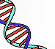
Complex Diseases
+
-
-
CVD
-
+
Diabetes
-
+
+
Stress
Cholesterol
+
-
Physical activity
Obesity
+
+
Pollution
+
-
Smoking
Fruits and Vegetables
+
Trans fatty acids
Slide adapted from Mente, A.
Notes:
genetic heterogeneity, which is the capacity of various genes to cause the same trait independently
Other things influence risk of developing CHD…
Other diseases (diabetes, obesity, hypertension)
Dietary components (fruits and vegetables, trans fats)
Environmental exposures (pollution, physical activity, stress)
And these all may interact with each other to modify risk

Slide 36
The complexity of interaction…
Genetic factors
Slide adapted from Mente, A.
Notes:
We all have a certain genetic makeup. The pathway from our genes to frank disease is complex.
What do we expose our genome to?

Slide 37
The complexity of interaction…
Genetic factors
Environmental exposures
Diet
Smoking
Stress
Slide adapted from Mente, A.
Notes:
We all have a certain genetic makeup. The pathway from our genes to frank disease is complex.
What do we expose our genome to?

Slide 38
The complexity of interaction…
Genetic factors
Environmental exposures
Diet
Smoking
Stress
Hypertension, Diabetes, Obesity,
Lipids, Genetic Background
Risk factors
Slide adapted from Mente, A.
Notes:
We all have a certain genetic makeup. The pathway from our genes to frank disease is complex.
What do we expose our genome to?

Slide 39
The complexity of interaction…
Genetic factors
Environmental exposures
Diet
Smoking
Stress
Hypertension, Diabetes, Obesity,
Lipids, Genetic Background
Risk factors
Atherosclerosis
Measurable trait
Slide adapted from Mente, A.
Notes:
We all have a certain genetic makeup. The pathway from our genes to frank disease is complex.
What do we expose our genome to?

Slide 40
The complexity of interaction…
Genetic factors
Environmental exposures
Diet
Smoking
Stress
Hypertension, Diabetes, Obesity,
Lipids, Genetic Background
Risk factors
Atherosclerosis
Measurable trait
Myocardial
Infarction
Peripheral
Vascular
Disease
Ischemic
Stroke
Phenotype
Slide adapted from Mente, A.
Notes:
We all have a certain genetic makeup. The pathway from our genes to frank disease is complex.
What do we expose our genome to?

Slide 41
The complexity of interaction…
Genetic factors
Environmental exposures
Diet
Smoking
Stress
Many levels of interaction make it challenging to know which interaction resulted in a phenotype!
Hypertension, Diabetes, Obesity,
Lipids, Genetic Background
Risk factors
Atherosclerosis
Measurable trait
Myocardial
Infarction
Peripheral
Vascular
Disease
Ischemic
Stroke
Phenotype
Slide adapted from Mente, A.
Notes:
We all have a certain genetic makeup. The pathway from our genes to frank disease is complex.
What do we expose our genome to?

Slide 42
So how can we study this?

Slide 43
Study designs for GxE
Study design | Advantages | Disadvantages
Case only | Cheaper; may be more efficient | Cannot estimate main effects; Assumes G & E are independent
Case-control (unrelated) | Broad inferences for population-based samples | Confounding due to population stratification is a danger
Case-control (related) | Minimizes potential for confounding | Overmatching for G & E; Not all cases can be used
Case-parent trios (case + 2 unaffected parents) | Avoids confounding; can test for GxE & GxG | Can’t test for E alone

Slide 44
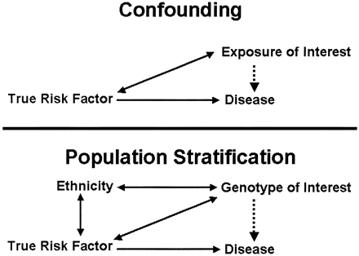
Wacholder, 2002 (www)

Slide 45
Population Stratification
When the risk of disease varies between two ethnic groups, then any factor—whether genetic or environmental—that also varies between the groups will appear to be related to disease
Any genotype that is more common in Americans of Chinese origin than in those of European origin will be positively associated with the “use of chopsticks” phenotype in studies that ignore ethnicity carried out in San Francisco (CA)
Wacholder, 2002 (www)

Slide 46
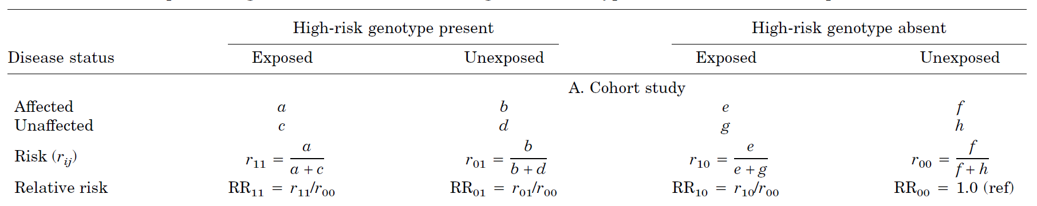
Effect measures in Genetic Epidemiology
Relative Risk (cohort study)
Denote | Exposure | High-Risk G
r₁₁ | yes | yes
r₁₀ | yes | no
r₀₁ | no | yes
r₀₀ | no | no

Slide 47
Assocation measures in Genetic Epidemiology
Relative Risk (cohort study)
  Let’s pick a disease
  Let’s pick a simple dietary factor that increases risk of disease
  Assume we have a SNP that also increases risk of disease (HRM728 rs8675309)
  Let’s generate some data
    No missing data
    No measurement error
    No confounding

Slide 48
Effect measures in Genetic Epidemiology
Relative Risk (cohort study)
High-risk genotype
Low-risk genotype
 | Exp+ | Exp-
D+
D-
Total
Risk
 | Exp+ | Exp-
D+ |  | 35
D- |  | 1600
Total |  | 1635
Risk |  | 35/1635
 |  | 0.021
This is our reference group
(Low G risk Low E risk)

Slide 49
Effect measures in Genetic Epidemiology
Relative Risk (cohort study)
High-risk genotype
Low-risk genotype
 | Exp+ | Exp-
D+
D-
Total
Risk
 | Exp+ | Exp-
D+ | 80 | 35 | 115
D- | 2360 | 1600 | 3960
Total | 2440 | 1635 | 4155
Risk | 80/2440 | 35/1635
 | 0.033 | 0.021
This group has
Low G risk High E Risk

Slide 50
Effect measures in Genetic Epidemiology
Relative Risk (cohort study)
High-risk genotype
Low-risk genotype
 | Exp+ | Exp-
D+ |  | 35
D- |  | 800
Total |  | 835
Risk |  | 35/835
 |  | 0.042
 | Exp+ | Exp-
D+ | 80 | 35 | 115
D- | 2360 | 1600 | 3960
Total | 2440 | 1635 | 4155
Risk | 80/2440 | 35/1635
 | 0.033 | 0.021
This group has
High G risk Low E Risk

Slide 51
Effect measures in Genetic Epidemiology
Relative Risk (cohort study)
High-risk genotype
Low-risk genotype
 | Exp+ | Exp-
D+ | 80 | 35 | 115
D- | 1165 | 800 | 1965
Total | 1245 | 835 | 2080
Risk | 80/1245 | 35/835
 | 0.064 | 0.042
 | Exp+ | Exp-
D+ | 80 | 35 | 115
D- | 2360 | 1600 | 3960
Total | 2440 | 1635 | 4155
Risk | 80/2440 | 35/1635
 | 0.033 | 0.021
This group has
High G risk High E Risk

Slide 52
Effect measures in Genetic Epidemiology
Relative Risk (cohort study)
Gene | Exposure | Notation | Risk | RR
Absent | Absent | r₀₀ | 0.021 | 1.00 (ref)
Absent | Present | r₁₀ | 0.033 | 1.57 (RR₁₀)
Present | Absent | r₀₁ | 0.042 | 2.00 (RR₀₁)
Present | Present | r₁₁ | 0.064 | 3.05 (RR₁₁)

Slide 53
Additive vs. Multiplicative
If C = A + B, then an effect is additive
If C = A x B, then an effect is multiplicative

Slide 54
Effect measures in Genetic Epidemiology
Models of Interaction: Additive (RR)
Type | Model | Example | Decision
No interaction | RR₁₁=RR₀₁+ RR₁₀ – 1 | 3.05 = 2.00 + 1.57-1 | False
Synergistic | RR₁₁>RR₀₁+ RR₁₀ – 1 | 3.05 > 2.00 + 1.57-1 | True
Antagonistic | RR₁₁<RR₀₁+ RR₁₀ – 1 | 3.05 < 2.00 + 1.57-1 | False
3.57
RR₁₁= 2.57 = 2.00₀₁ + 1.57₁₀ -1
expected result for additive effect

Slide 55
Effect measures in Genetic Epidemiology
Models of Interaction: Multiplicative (RR)
Type | Model | Example | Decision
No interaction | RR₁₁=RR₀₁ × RR₁₀ | 3.05 = 2.00 × 1.57 | True
Synergistic | RR₁₁>RR₀₁ × RR₁₀ | 3.05 > 2.00 × 1.57 | False
Antagonistic | RR₁₁<RR₀₁ × RR₁₀ | 3.05 < 2.00 × 1.57 | False
3.14
RR₁₁= 3.14 = 2₀₁ x 1.57₁₀
expected result for multiplicative effect

Slide 56
A more striking example
Association between OCP and VT has been known since early 1960s
Led to development of OCP with lower estrogen content
  Incidence of VT is ~12 to 34 / 10,000 in OCP users
Risk of VT is highest during the 1st year of exposure
Slide adapted from Mente, A.
Notes:
56
OCP increases risk of VT.

Slide 57
Factor V Leiden Mutations
R506Q mutation – amino acid substitution
Geographic variation in mutation prevalence
  Frequency of the mutation in Caucasians is~2% to 10%
  Rare in African and Asians
Prevalence among individuals with VT
  14% to 21% have the mutation
Relative risk of VT among carriers
  3- to 7-fold higher than non-carriers
Slide adapted from Mente, A.
Notes:
57
A mutation in Factor V Leiden, which results in an amino acid substitution, also increases risk of VT.

Slide 58
Case-control Study
Collect exposure information (historical) on subjects
Classify subjects according to exposure status
  Exposed
  Not exposed

Slide 59
Case-control Study
Were exposed
Were not
exposed
Were exposed
Were not
exposed
Have the disease (cases)
Do not have the disease (controls)

Slide 60
Case-control Study (2x2 table)
 | Exposed | Not exposed
Cases
Controls

Slide 61
Case-control Study (2x2 table)
 | Exposed | Not exposed
Cases | E+ D+
Controls

Slide 62
Case-control Study (2x2 table)
 | Exposed | Not exposed
Cases | E+ D+ | E-D+
Controls

Slide 63
Case-control Study (2x2 table)
 | Exposed | Not exposed
Cases | E+ D+ | E-D+
Controls | E+D-

Slide 64
Case-control Study (2x2 table)
 | Exposed | Not exposed
Cases | E+ D+ “A” | E-D+ “B”
Controls | E+D- “C” | E-D- “D”

Slide 65
OCP, Factor V Leiden Mutations and Venous Thrombosis
Strata | Cases | Controls
G+E+ | 25 | 2
G+E- | 10 | 4
G-E+ | 84 | 63
G-E- | 36 | 100
OR (95% CI)
34.7 (7.8, 310.0)
6.9 (1,8, 31.8)
3.7 (1.2, 6.3)
Reference
Total 155 169
Lancet 1994;344:1453
Notes:
65
These data are presented in the cited manuscript. Individuals who do not carry the mutation but have been exposed to OCP have a ~4-fold increased risk of VT than those who do not carry the mutation and were not exposed to OCP. Those who carry the mutation but have not used OCP have a ~7-fold increased risk of VT compared to those do not carry the mutation or used OCP. However, the risk for individuals with the mutation and exposure to OCP is very high, ~35 times greater than the risk for women with neither the mutation or exposure to OCP.

Slide 66
Additive Effect?
OR_{INT} = OR_{G+E+} / (OR_{G+E-} + OR_{G-E+} - 1) = 1
Strata OR
G+E+ 34.7
G+E- 6.9
G-E+ 3.7
G-E- Ref
OR _{Interaction} =
34.7 / (6.9 + 3.7 - 1) = 3.58
Notes:
66
To determine if there is an additive effect between the mutation and exposure to OCP, the equation illustrated in slide 12 was used with the data from slide 22. Clearly, there is not an additive effect between the Factor V Leiden mutation and OCP use in terms of increasing risk of VT. There may be interaction if the multiplicative model is also rejected.

Slide 67
Multiplicative Effect?
OR_{INT} = OR_{G+E+} / (OR_{G+E-} * OR_{G-E+}) = 1
Strata OR
G+E+ 34.7
G+E- 6.9
G-E+ 3.7
G-E- Ref
OR _{Interaction} =
34.7 / 6.9 x 3.7 = 1.4
Multiplicative appears to fit the data better than additive
Notes:
67
To determine if there is a multiplicative effect between the mutation and exposure to OCP, the equation illustrated in slide 14 was used with the data from slide 22. There does appear to be a multiplicative effect between Factor V Leiden mutation and OCP use in terms of increasing risk of VT because the OR for interaction is ~ 1.

Slide 68
Prevalence of Mutation in Controls
Stratum | Prevalence
G+E+ | 1.2%
G+E- | 2.4%
G-E+ | 37.3%
G-E- | 59.2%
Used incidence of 2.1/10,000/yr to determine the number of person years that would be required for 155 new (incident) cases to develop.
Used prevalence rates of mutation in controls to estimate the distribution of person years for each strata
Notes:
68
The table above illustrates the distribution of the Factor V Leiden mutation (S+) and exposure to OCP (E+) in the control population.
To determine the absolute risk (incidence) of VT among women in the 4 groups, the authors used the known incidence rate of VT in the population (2.1/10,000/yr) to determine the total number of person years required for the 155 observed cases of VT to develop. This number was ~740,000 person years, and they were distributed among the 4 groups according to the prevalence rates shown above. For example, 740,000 x 0.012 = ~8880 person years required for the 25 cases in the S+E+ group (shown in slide 22) to have occurred. Therefore, the incidence of VT among women who had the Factor V Leiden mutation and were exposed to OCP could be estimated as 25 / 8,880 x 10,000 = 28/10,000 per year. These calculations were repeated for each of the groups and are illustrated on slide 26.

Slide 69
Absolute Risk (Incidence) of VT
Strata | Risk/10,000/yr
G+E+ | 28.5
G+E- | 5.2
G-E+ | 3.0
G-E- | 0.8
Notes:
69
This slide shows the estimated incidence rates for VT for the 4 groups of susceptible and exposed women.
Note - using the method to estimate absolute risk that was illustrated in the previous lecture ‘Absolute, Relative and Attributable Risk’, the incidence rates for VT are almost identical to those estimated by the authors by distributing the person years according to the prevalence of the risk factors. Therefore, this is another approach that can be used to estimate absolute risk (incidence) from a case control study when the overall population incidence rate is known.

Slide 70
Attributable Risk (AR)
Strata | AR per 10,000/yr | To prevent 1 ‘excess’ event per year, need to screen:
S+E+ | 27.7 | *429 (27.2-4.4)= 23.3/10,000 or 1/429 * Note: only assess excess risk among S+ people since S- people who get tested will likely take OCPs
S+E- | 4.4
S-E+ | 2.2
S-E- | Baseline
27.7/28.5 = 97%
Notes:
70
The AR shows the actual incidence of disease that is due to the Factor V Leiden mutation and/or exposure to OCP use. If women were given the option of being tested for the Factor V Leiden mutation, and those who were positive did not use OCP, then 97% of the cases of VT in this group of women could be prevented.

Slide 71
Today’s objectives
Does diet cause disease?
Why study gene-diet interactions?
What do we mean by interaction?
Methodological approaches to studying gene-diet interaction
Public Health implications

Slide 72
Modeling
What biological models might bring about these interactions?
  How would our understanding of the biology affect our predictions about interactions?

Slide 73
Modeling
PKU
Mental retardation
phenylalanine
The genotype modifies production of an environmental risk factor than can be produced non-genetically. Examples could be high blood phenylalanine in PKU. Effect of genotype operates through phenylalanine; if you limit P, no disease.

Slide 74
A through E examples
MODEL A
Heavy Drinking
Epilepsy
Genetic susceptibility

Slide 75
A through E examples
MODEL A
Heavy Drinking
Epilepsy
Genetic predisposition to drink
Genetic susceptibility

Slide 76
Modeling
RR₁₁ | RR₀₁ | RR₁₀ | RR₀₀
>>1 | 1 | >1 | 1
Ischemic Stroke
UV Exposure
Skin cancer
The genotype exacerbates the effect of an environmental risk factor but there is no risk in unexposed persons. Examples could be xeroderma pigmentosum. UV exposure increases risk of skin cancer in everyone; but worse here. No sun = no cancer. Common diet model!

Slide 77
A through E examples
MODEL B
Heavy Drinking
Epilepsy
Gene changes the way the brain metabolizes alcohol
Genetic susceptibility

Slide 78
Modeling
RR₁₁ | RR₀₁ | RR₁₀ | RR₀₀
>>1 | >1 | 1 | 1
The genotype exacerbates the effect of the exposure, but no effect in persons with low-risk genotype. Example could be porphyria variegata; unusual sun sensitivity and blistering, but barbiturates are lethal. In people without it, no D.

Slide 79
A through E examples
MODEL C
Drinking exacerbates risk in those already susceptible
Heavy Drinking
Epilepsy
Genetic susceptibility raises risk, regardless of drinking
Genetic susceptibility

Slide 80
Modeling
RR₁₁ | RR₀₁ | RR₁₀ | RR₀₀
>1 | 1 | 1 | 1
Both the genotype and the environmental risk factor are necessary to increase risk of disease; for example fava beans eaten by people with glucose-6-phostphatase deficiency.

Slide 81
A through E examples
MODEL D
Heavy Drinking
Epilepsy
Only those with the gene who drank heavily would be at high risk
Genetic susceptibility

Slide 82
Modeling
RR₁₁ | RR₀₁ | RR₁₀ | RR₀₀
?? | >1 | >1 | 1
Both the genotype and the environmental risk factor have independent effects on disease; together the risk is higher or lower than when they occur alone. Common diet model!

Slide 83
A through E examples
MODEL E
Independently + or - risk
Heavy Drinking
Epilepsy
Independently + or - risk
Genetic susceptibility

Slide 84
Briefly, Statistical Issues

Slide 85
Association Studies: Potential Causes of Inconsistent Results
Population stratification: differences between cases and controls (most often cited reason)
Genetic heterogeneity: different genetic mechanisms in different populations
Random error: false positive/negative results
Study design/analysis problems:
  poorly defined phenotypes
  failure to correct for subgroup analyses and multiple comparisons
  poor control group selection
  small sample sizes
  failure to attempt replication
Slide adapted from Mente, A.
Silverman and Palmer, Am J Respir Cell Mol Biol 2000

Slide 86
Power depends on the genetic model
Slide adapted from Mente, A.
Palmer & Cardon, Lancet 2005

Slide 87
Approach #1
Cross-sectional studies
  Genetic Risk Score
  High saturated fat
  Obesity

Slide 88
MESA and GOLDN
Genetic contribution to inter-individual variation in common obesity is 40-70%
Genome-wide association studies have identified several genetic variants associated with obesity (i.e. BMI, weight, WC, WHR)
gene-diet interaction models usually consider only a single SNP, which may explain a very small % of variation in body weight
Combing several susceptibility genes into a single score may be more powerful

Slide 89
MESA and GOLDN
Objective was to analyze the association between an obesity GRS and BMI in the Genetics of Lipid Lowering Drugs and Diet Network (GOLDN) and the Multiethnic Study of Atherosclerosis (MESA)

Slide 90
MESA and GOLDN

Slide 91
Cross-sectional studies
Let’s refresh our memories…

Slide 92
Cross-sectional studies
What is the measure of association in a cross-sectional study?

Slide 93
Cross-sectional studies
What is the measure of association in a cross-sectional study?
  Prevalence association

Slide 94
Cross-sectional studies
What does this measure tell you?

Slide 95
Cross-sectional studies
What does this measure tell you?
  The association between exposure and outcome at a given point in time

Slide 96
Cross-sectional studies
Why can we not calculate a risk ratio in a case-control study?

Slide 97
Cross-sectional studies
Why can we not calculate a risk ratio in a case-control study?
  No time metric; don’t know what causes what

Slide 98
Cross-sectional studies
What are the advantages to this approach?

Slide 99
Cross-sectional studies
What are the advantages to this approach?
  Cheaper
  Less time-consuming
  Descriptive
  Examine associations

Slide 100
Cross-sectional studies
What are the pitfalls to this approach?

Slide 101
Cross-sectional studies
What are the pitfalls to this approach?
  Selection bias: cases and controls from different populations
  Lack of temporality: not sure what comes first…
  Lack of causality: can only report association

Slide 102
Methods
N=2,817 participants
  GOLDN: n=782 Age = 49 ± 15 y
  MESA: n=2,035 Age = 63 ± 10 y
Diet measures
  GOLDN: validated diet history Q
  MESA: FFQ modified from IRAS

Slide 103
Obesity Genetic Risk Score
Cohort | GOLDN | MESA
# SNPs | 63 | 59
Max Score | 126 | 118
Max Weight | 47.56 | 19.34
Score | x/47.56 * 126 | x/19.34 x 118

Slide 104
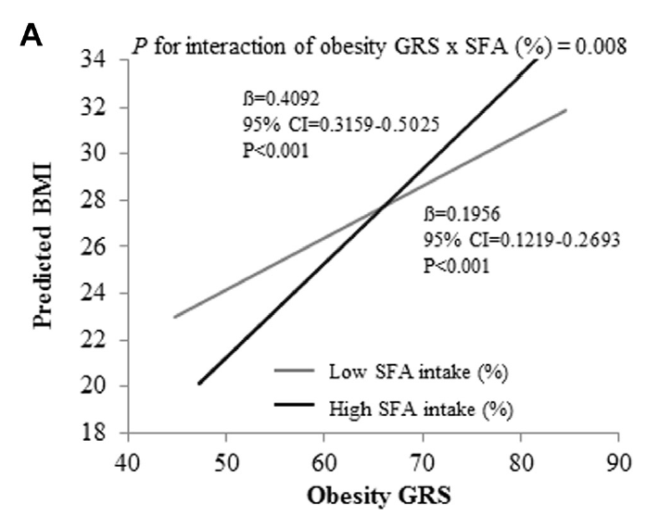
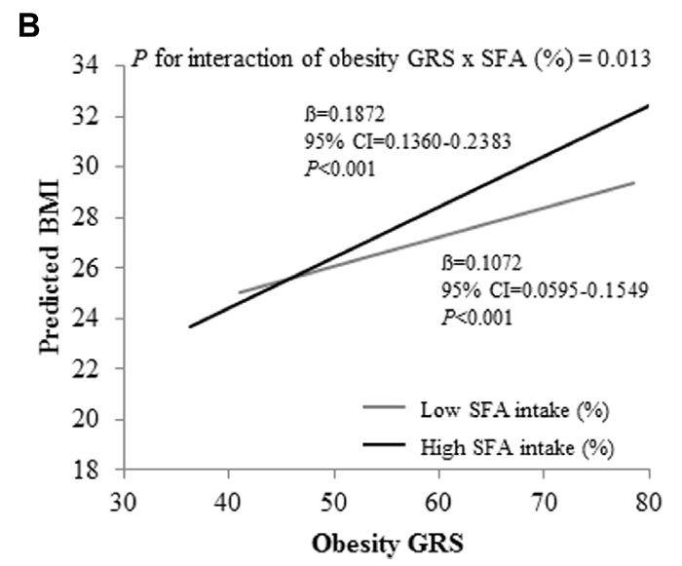
Results
GOLDN
MESA

Slide 105
Results
The slope of the line relating a 1-unit change in GRS was steeper in both GOLDN and MESA in those eating higher saturated fat
GOLDN
MESA

Slide 106
Design Issues
Used a weighted obesity GRS
  Explains greater variability in obesity (3.7 to 11.1%) than individual SNPs (0.1% to 1.9%)
Used validated dietary measurement instruments
Cross-sectional

Slide 107
Approach #2
Case-Cohort Study
  Genetic Risk Score
  Environmental Exposures
  Type 2 diabetes

Slide 108
EPIC-InterAct
GWAS studies of prevalent diabetes cases helped to identify common (>5%) genetic variants associated with type 2 diabetes
These variants, however, explained only 10% of the heritability of type 2 diabetes (Billings and Flores, 2010)
Interactions between genetic factors and lifestyle exposures, gene-gene interactions, and genetic variation other than common SNPs explain part of the remaining 90%
The InterAct Consortium, Diabetologia, 2011

Slide 109
EPIC-InterAct
Existing case-control studies that identify genetic loci associated with t2dm aren’t designed to look at interactions
  Underpowered
  Lack standardized measures of lifestyle factors
  Not prospective in nature
The InterAct Consortium, Diabetologia, 2011

Slide 110
EPIC-InterAct Objective
To investigate interactions between genetic and lifestyle factors in a large case-cohort study nested within the European Prospective Investigation into Cancer and Nutrition
The InterAct Consortium, Diabetologia, 2011

Slide 111
Case-control studies
Let’s refresh our memories…

Slide 112
Case-control studies
What is the measure of association in a case-control study?

Slide 113
Case-control studies
What is the measure of association in a case-control study?
  Odds Ratio

Slide 114
Case-control studies
What does this measure tell you?

Slide 115
Case-control studies
What does this measure tell you?
  odds that an outcome will occur given a particular exposure, compared to the odds of the outcome occurring in the absence of that exposure

Slide 116
Case-control studies
Why can we not calculate a risk ratio in a case-control study?

Slide 117
Case-control studies
Why can we not calculate a risk ratio in a case-control study?
  Because we do not have complete characterization and prospective follow-up of the “study base” from which to calculate incidence rates of disease

Slide 118
Case-control studies
What are the advantages to this approach?

Slide 119
Case-control studies
What are the advantages to this approach?
  Cheaper
  Less time-consuming
  OR ≈ RR when disease is “rare”

Slide 120
Case-control studies
What are the pitfalls to this approach?

Slide 121
Case-control studies
What are the pitfalls to this approach?
  Selection bias: cases and controls from different populations
  Recall bias: exposure information gathered retrospectively

Slide 122
Case-control studies
  How might we overcome these pitfalls?

Slide 123
EPIC-InterAct
Case-Cohort design
  Nested within a large prospective cohort
    Know the study base
  Controls are a random sample of the cohort
    Can be used in design and analysis of future studies of diseases in this cohort (i.e. not matched on type 2 diabetes risk factors)
  Efficiency of a case-control
    Don’t have to wait for cases to occur
    Don’t have to analyze markers on everyone
  Advantages of a longitudinal cohort
    Extensive prospective assessment of key exposures
    No recall bias
The InterAct Consortium, Diabetologia, 2011

Slide 124
EPIC and EPIC InterAct
8 countries: EPIC InterAct (455,680)
Minus Norway and Greece
10 countries: EPIC (519,978)

Slide 125
The EPIC Cohort

Slide 126
The EPIC InterAct Cohort
Country | Sites | Period | N | Samples N | % women | Age
France | 6 | 1993-1996 | 74,524 | 21,086 | 100 | 44-65
Italy | 5 | 1992-1998 | 47,749 | 47,228 | 66 | 36-64
Spain | 5 | 1992-1996 | 41,438 | 39,829 | 62 | 36-64
UK | 2 | 1993-1998 | 87,930 | 43,277 | 69 | 24-74
Netherlands | 2 | 1993-1997 | 40,072 | 36,318 | 74 | 23-68
Germany | 2 | 1994-1998 | 53,088 | 50,680 | 57 | 36-64
Sweden | 2 | 1991-1996 | 53,826 | 53,781 | 57 | 30-71
Denmark | 2 | 1993-1997 | 57,053 | 56,130 | 52
Total |  |  | 455,680 | 348,828
8 of 10 countries from EPIC participated

Slide 127
The EPIC InterAct Cohort
Dietary assessment
  Self or interviewer-administered dietary questionnaire (developed and validated within each country)
Physical activity
  Brief questionnaire of occupational and recreational activity (validated in Netherlands only)
Biological samples
  Blood plasma, blood serum, WBC, erythrocytes
  340,234 complete samples
  Stored in -196°C in liquid nitrogen

Slide 128
The EPIC InterAct Cohort
Case ascertainment
  12,403 verified incident cases over 3.99 million p-y
  Excluded prevalent cases based on self-report
  Incident cases identified through self-report, linkage to primary and secondary-care registers, drug registers, hospital admissions, mortality data
Control selection
  16,154 randomly sampled with available stored blood and buffy coat, stratified by centre

Slide 129
The EPIC InterAct Cohort
Overall findings
  HR: 1.50 (1.38 to 1.63) for men vs. women
  HR: 1.45 (1.35 to 1.55) per 10 y of age in men
  1.64 (1.55 to 1.74) per 10 y of age in women

Slide 130
EPIC InterAct: Gene x Lifestyle
Objective was to determine interaction between genetic risk score and lifestyle risk factors for type 2 diabetes
  Sex, family history, age
  Measures of obesity (BMI, WHR)
  Physical activity
  Diet (Mediterranean diet score)

Slide 131
EPIC InterAct: Gene x Diet
Usual food intake estimated using country-specific, validated dietary questionnaires
Nutrient intake calculated using the EPIC nutrient database
Assessed adherence to the Mediterranean dietary pattern using relative Mediterranean diet score (rMED)
Romaguera et al., Diab Care, 2011

Slide 132
EPIC InterAct: rMED
Beneficial | Top/Med/Bot | Detrimental | Top/Med/Bot
Vegetables | 2/1/0 | meat/meat products | 0/1/2
Legumes | 2/1/0 | dairy | 0/1/2
Fruits and nuts | 2/1/0
Cereals | 2/1/0
Fish and seafood | 2/1/0
Olive oilª | 2/1/0
Moderate alcohol^{b} | 2/1/0
MAX SCORE = 18 Min SCORE = 0
a = 0 for non-consumers; 1 for below median; 2 for above median
b = 2 for 10-50 g (M) or 5-25 g (W) 0 otherwise
Romaguera et al., Diab Care, 2011

Slide 133
EPIC InterAct: rMED
Category | Score
Low | 0-6
Medium | 7-10
High | 11-18
Romaguera et al., Diab Care, 2011

Slide 134
EPIC InterAct: Genetic Risk Score
Selected all top-ranked SNPs found to be associated with T2D in DIAGRAM meta-analysis (n=66)
  Excluded DUSP8 (parent-of-origin effect)
  Excluded 15 variants for Asian population only
49 genetic variants made up a genetic risk score
  Sum the number of risk alleles (MIN: 0 MAX: 49)
Romaguera et al., Diab Care, 2011

Slide 135
EPIC InterAct: Results
Gene/Score | HR | Lower CI | Upper CI | P-value
Each SNP | >1.00 for risk allele | ≥0.91 | ≤1.42 | <0.05 for 35
G score (imputed) | 1.08 per allele | 1.07 | 1.10 | 1.05 x 10-41
G score (imputed) | 1.41 per SD (4.37) | 1.34 | 1.49 | 1.05 x 10-41
G score (imputed, weighted) | 1.47 per SD (0.43) | 1.41 | 1.54 | 5.77 x 10-64
G (non-imputed, unweighted) | 1.41 per SD (4.37) | 1.34 | 1.49 | 1.67 x 10-40
G (non-imputed, weighted) | 1.47 per SD (0.43) | 1.41 | 1.54 | 1.30 x 10-61
Imputed: imputed with mean genotype in overall dataset at each locus for Ca, Co separately
Weighted: by log (OR) for that SNP in DIAGRAM replication samples
Romaguera et al., Diab Care, 2011

Slide 136
EPIC InterAct: Results
Clearly, we see that as genetic risk score increases, so does risk of type 2 diabetes
RR: 1.41 (1.34 to 1.49) per 4.4 alleles
Romaguera et al., Diab Care, 2011

Slide 137
EPIC InterAct: Results
I²=56%
Not accounted for by age, BMI, or WC
Romaguera et al., Diab Care, 2011

Slide 138
EPIC InterAct: Gene x Environment
P-values for interaction
  Parameter representing the interaction term between the score and factor of interest within each country
    A cross-product term (genotype x factor score)
  Additionally adjusted for centre and sex, with age as the time scale
  Pool the interaction parameter estimates across countries using random-effects model
  Bonferonni-adjusted values (P<0.05/7 = 0.0071)
Romaguera et al., Diab Care, 2011

Slide 139
EPIC InterAct: Results
Romaguera et al., Diab Care, 2011

Slide 140
EPIC InterAct: Results
Gene score was more strongly associated with risk in
  Younger cohorts
  Leaner cohorts
What are the population health impacts of this finding?
Romaguera et al., Diab Care, 2011

Slide 141
EPIC InterAct: Results
Romaguera et al., Diab Care, 2011

Slide 142
EPIC InterAct: Results
<25
25 to <30
>=30
Romaguera et al., Diab Care, 2011

Slide 143
EPIC InterAct: Results
Table S6. 10-y Cumulative incidence (%) of type 2 diabetes across GRS and BMI
GRS | <25 | 25 to <30 | >=30
Q1 | 0.25 | 1.29 | 4.22
Q2 | 0.44 | 2.03 | 5.78
Q3 | 0.53 | 2.50 | 5.83
Q4 | 0.89 | 3.33 | 7.99
<25
25-<30
≥30
2 key points:
1. At any level of GRS, higher BMI increased CI
2. At any level of BMI, higher GRS increased CI
Romaguera et al., Diab Care, 2011

Slide 144
EPIC InterAct: Results
<94 m <80 w
94 to <102 m 80 to <88 w
>102 m >88 w
Romaguera et al., Diab Care, 2011

Slide 145
EPIC InterAct: Results
Table S7. 10-y Cumulative incidence (%) of type 2 diabetes across GRS and WC
GRS | Low | Medium | High
Q1 | 0.29 | 0.95 | 3.50
Q2 | 0.48 | 1.66 | 5.08
Q3 | 0.66 | 1.78 | 5.50
Q4 | 1.01 | 2.92 | 6.64
<94 m <80 w
94 to <102 m 80 to <88 w
>102 m >88 w
2 key points:
1. At any level of GRS, higher WC increased CI
2. At any level of WC, higher GRS increased CI
Romaguera et al., Diab Care, 2011

Slide 146
EPIC InterAct: Results
11-18 High
7-10 Medium
0-6 Low
Romaguera et al., Diab Care, 2011

Slide 147
EPIC InterAct: Results
Table S9. 10-y Cumulative incidence (%) of type 2 diabetes across GRS and rMDS
GRS | Low | Medium | High
Q1 | 1.45 | 1.25 | 1.04
Q2 | 2.03 | 1.89 | 1.58
Q3 | 2.76 | 2.02 | 1.88
Q4 | 3.27 | 3.01 | 2.75
11-18 High
7-10 Medium
0-6 Low
2 key points:
1. At any level of GRS, higher rMDS decreased CI
2. At any level of rMDS, higher GRS increased CI
Romaguera et al., Diab Care, 2011

Slide 148
EPIC InterAct: Importance
Largest study of T2D with measures of genetic susceptibility
High statistical power
Participants in whom genetic risk score is strongest are at LOW absolute risk…
Absence of gene-environment interaction emphasizes the importance of lifestyle in prevention of T2DM
Romaguera et al., Diab Care, 2011

Slide 149
Approach #3
Randomized controlled trial
  SNP-based
  Randomization to diets of various macronutrient compositions
  Body composition

Slide 150
POUNDS LOST
Randomized controlled trial of 4 diets, differing in protein, carbohydrate, and fat for weight loss (Sacks et al., NEJM, 2009)
Main papers found no overall influence of dietary macronutrients on changes in body weight, waist circumference, or body composition over 2 years (Sacks et al., 2009; de Souza et al., 2011)

Slide 151
Randomized Controlled Trials
Let’s refresh our memories…

Slide 152
Randomized Controlled Trials
Why are these considered the “gold standard” of medical evidence?

Slide 153
Randomized Controlled Trials
Why are these considered the “gold standard” of medical evidence?
  Balances known and unknown confounders
  Isolates the effect of treatment on the outcome of interest
  Allows you to determine “causality”

Slide 154
POUNDS LOST
2-y RCT for weight loss
N=811 participants on one of 4 energy-restricted diets
Diet | Carb | Protein | Fat
Avg Protein, Low Fat | 65 | 15 | 20
High Protein, Low Fat | 55 | 25 | 20
Avg Protein, High Fat | 45 | 15 | 40
High Protein, High Fat | 35 | 25 | 40

Slide 155
POUNDS LOST
Sacks et al., NEJM, 2008

Slide 156
POUNDS LOST
Sacks et al., NEJM, 2008

Slide 157
POUNDS LOST
de Souza et al., AJCN, 2012

Slide 158
POUNDS LOST
de Souza et al., AJCN, 2012

Slide 159
POUNDS LOST
Population genetic studies show common variants in TCF7L2 predict type 2 diabetes; contradictory effects on body weight
These studies examined interaction between dietary fat assignment (20% vs. 40%) on changes in body weight and composition, glucose, insulin, and lipid profiles in self-identified White participants
Mattei et al., AJCN, 2012; Zhang et al., 2012

Slide 160
POUNDS LOST: Methods
To avoid population stratification, restricted analysis to individuals who self-identified as white (n=643), 50% of whome (n=326) were randomly selected to receive DXA scans
DNA extraction by QIAmp Blood Kit and polymorphisms rs7903146 and rs1255372 genotyped with OpenArray SNP Genotyping system (BioTrove)
Mattei et al., AJCN, 2012

Slide 161
POUNDS LOST: Methods
Hardy Weinberg Equilibrium
  In a large randomly breeding population, allelic frequencies will remain the same from generation to generation assuming that there is no mutation, gene migration, selection or genetic drift
 | Rs7903146 O%/E% |  | Rs12255372 O%/E%
CC | 49.4/49.8 | GG | 51.6/51.7
CT | 42.1/41.5 | GT | 40.6/40.4
TT | 8.3/8.7 | TT | 7.9/7.8
Chi-square | 0.736 |  | 0.886
Mattei et al., AJCN, 2012

Slide 162
POUNDS LOST: Results
Overall, no differences in change from baseline to 6 months or 2 years by TCF7L2 genotype
But what happens when we look by diet assignment…?
  For rs12255372, we see an interaction between dietary fat level and change in BMI, total fat mass, and trunk fat mass
Mattei et al., AJCN, 2012

Slide 163
POUNDS LOST: TCF7L2 rs12255372
20% Fat
40% Fat
Mattei et al., AJCN, 2012

Slide 164
POUNDS LOST: TCF7L2 rs12255372
TT homozygotes lose more weight, fat mass, and trunk fat on low-fat diets after 6 months than on high-fat diets with similar energy restriction
20% Fat
40% Fat
Mattei et al., AJCN, 2012

Slide 165
POUNDS LOST: TCF7L2 rs12255372
TT homozygotes lose more weight, fat mass, and trunk fat on low-fat diets after 6 months than on high-fat diets with similar energy restriction
20% Fat
40% Fat
Mattei et al., AJCN, 2012

Slide 166
POUNDS LOST: TCF7L2 rs7903146
20% Fat
40% Fat
Mattei et al., AJCN, 2012

Slide 167
POUNDS LOST: TCF7L2 rs7903146
CC homozygotes lose more lean mass on low-fat diets after 6 months than on high-fat diets with similar energy restriction
20% Fat
40% Fat
Mattei et al., AJCN, 2012

Slide 168
POUNDS LOST: TCF7L2 rs12255372
15% Protein
25% Protein
Mattei et al., AJCN, 2012

Slide 169
POUNDS LOST: TCF7L2 rs12255372
Carriers of 1 G-allele tended lo lose more lean mass on low-protein diets than TT homozygotes
15% Protein
25% Protein
Mattei et al., AJCN, 2012

Slide 170


POUNDS LOST: APOA5 rs964184
Zhang et al., AJCN, 2012

Slide 171
POUNDS LOST: APOA5 rs964184
←More G-alleles resulted in better cholesterol-lowering following weight loss on low-fat diets
Zhang et al., AJCN, 2012

Slide 172
POUNDS LOST: APOA5 rs964184
More G-alleles resulted in → better LDL-cholesterol-lowering following weight loss on low-fat diets
Zhang et al., AJCN, 2012

Slide 173
POUNDS LOST: APOA5 rs964184
←More G-alleles resulted in greater HDL-C increases following weight loss on high-fat diets
Zhang et al., AJCN, 2012

Slide 174
POUNDS LOST: APOA5 rs964184
Those assigned to the low-fat diet had a much sharper rate of decrease in TC and LDL-C over 6 months, and lower values overall after 2 years
Zhang et al., AJCN, 2012

Slide 175
POUNDS LOST: FTO rs1558902
Zhang et al., Diabetes, 2012

Slide 176
POUNDS LOST: FTO rs1558902
Those with T-alleles lost more fat-free mass on low-protein diets; high protein diets better preserved lean mass
Zhang et al., Diabetes, 2012

Slide 177
POUNDS LOST: FTO rs1558902
Zhang et al., Diabetes, 2012

Slide 178
POUNDS LOST: FTO rs1558902
Greater TAT change per T-allele on average protein;
Greater TAT change per A-allele on high-protein
Zhang et al., Diabetes, 2012

Slide 179
POUNDS LOST: FTO rs1558902
Zhang et al., Diabetes, 2012

Slide 180
POUNDS LOST: FTO rs1558902
Greater VAT change per T-allele on average protein;
Greater VAT change per A-allele on high-protein
Zhang et al., Diabetes, 2012

Slide 181
POUNDS LOST: FTO rs1558902
Zhang et al., Diabetes, 2012

Slide 182
POUNDS LOST: FTO rs1558902
Greater SAT change per T-allele on average protein;
Greater SAT change per A-allele on high-protein
Zhang et al., Diabetes, 2012

Slide 183
POUNDS LOST: FTO rs1558902
Zhang et al., Diabetes, 2012

Slide 184
POUNDS LOST: FTO rs1558902
Zhang et al., Diabetes, 2012

Slide 185
POUNDS LOST: FTO rs1558902
Zhang et al., Diabetes, 2012

Slide 186
POUNDS LOST: Results
Weight loss was a significant predictor of changes in glucose and insulin on both high- and low-fat diets in those with the G allele (rs12255372)
Weight loss was only a significant predictor of changes in glucose and insulin on low-fat diets in those homozygous TT
Mattei et al., AJCN, 2012

Slide 187
POUNDS LOST: Implications
The early interaction between genotype and fat level did not persist after 6 months…
  Did the effect disappear; or did adherence diminish so much that the ability to detect between-diet difference was lost?
Further complicates the question of “optimal diets” for weight loss
Mattei et al., AJCN, 2012

Slide 188
POUNDS LOST: Implications
FTO SNP may interact with dietary protein to predict amount and location of fat mass lost in response to weight loss
APO A5 SNP may interact with dietary fat affect blood lipid response to weight reduction
Mattei et al., AJCN, 2012

Slide 189
Epigentics
heritable changes in gene expression that does not involve changes to the underlying DNA sequence
a change in phenotype without a change in genotype
influenced by several factors including age, the environment/lifestyle, and disease state

Slide 190
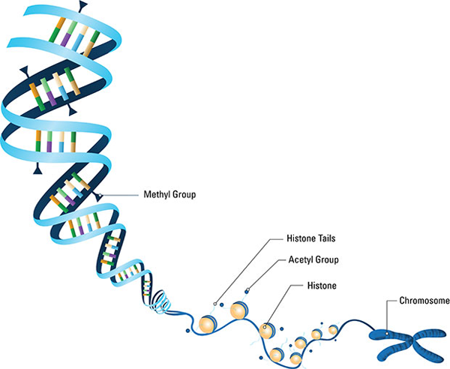
Epigentics

Slide 191
Approach #1
Randomized controlled crossover trial
  Randomization to high-fat feeding
  Measure genome-wide DNA methylation change after 5 days of high-fat feeding

Slide 192
Approach
Randomized controlled crossover trial
  Randomization to high-fat feeding
  Measure genome-wide DNA methylation change after 5 days of high-fat feeding

Slide 193
Randomized Controlled Trials
What are the advantages of crossover vs. parallel trials?

Slide 194
Randomized Controlled Trials
What are the advantages of crossover vs. parallel trials?
  Subjects serve as their own control
  Tight control over confounding
  Need smaller sample size because you minimize between-subjects variance in response

Slide 195
Randomized Controlled Trials
What are the disadvantages of crossover vs. parallel trials?

Slide 196
Randomized Controlled Trials
What are the disadvantages of crossover vs. parallel trials?
  Need to ensure that at the start of each intervention period, the participants have returned to “baseline” state
  If not, you run the risk of contamination of “control” with “treatment” effects, diluting effect size…

Slide 197
Jacobsen et al., 2012
Diets rich in genistein (a soy isoflavone) and methyl donors (folate) modulate DNA methylation patterns in rodent offspring of mothers
These changes in methylation patterns influence offspring’s incidence of obesity, diabetes, cancer
Does a short-term high-fat diet induce widespread changes in DNA methylation and targeted gene expression in skeletal muscle?

Slide 198
Jacobsen et al., 2012
Randomized crossover trial (n=21)

Slide 199
Jacobsen et al., 2012
The diets:
  Controlled feeding
  HIGH FAT OVERFEEDING (HFO): 60% fat, 32.5% carbohydrate, 7.5% protein at 150% of energy needs
  CONTROL (CON): 35% fat, 50% carbohydrate, 15% protein at 100% of energy needs
What’s the advantage of such a big difference in diet?

Slide 200
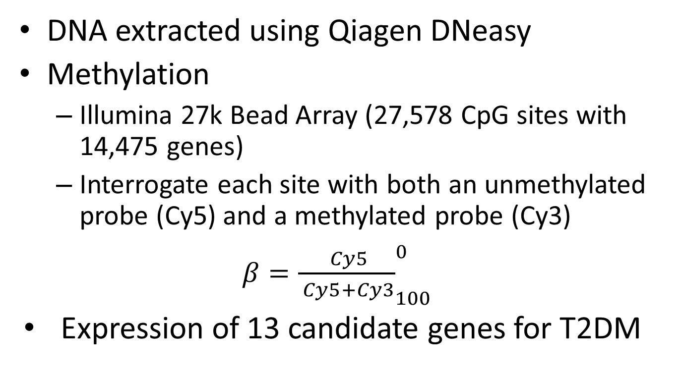
Jacobsen et al., 2012
  DNA extracted using Qiagen DNeasy
Methylation
  Illumina 27k Bead Array (27,578 CpG sites with 14,475 genes)
  Interrogate each site with both an unmethylated probe (Cy5) and a methylated probe (Cy3)
  $β={\frac{ Cy5}{ Cy5+Cy3}}_{100}^{0}$
Expression of 13 candidate genes for T2DM

Slide 201
Methylation Changes: After HFO
Hypomethylated
Hypermethylated

Slide 202
Methylation Changes: After HFO
Those who got the HFO first tended to be by hypermethylated after HFO
Those who got the control diet first, tended to by hypomethylated after HFO
-changes are reversible
Hypomethylated
Hypermethylated

Slide 203
Methylation Changes
CONTROL-DIET FIRST:
  29% (7,909) CpG sites (6,508 genes) changed in response to switching to HFO (P<0.0001 vs. 5% expected)
  3.5% mean change
    83% of sites that changed increased (but 98% were still <25% methylated)

Slide 204
Methylation Changes
CONTROL-DIET FIRST:
  29% (7,909) CpG sites (6,508 genes) changed in response to switching to HFO (P<0.0001 vs. 5% expected)
  3.5% mean change
    83% of sites that changed increased (but 98% were still <25% methylated)

Slide 205
Methylation Changes
HFO minus Control

Slide 206
Methylation Changes
HFO minus Control

Slide 207
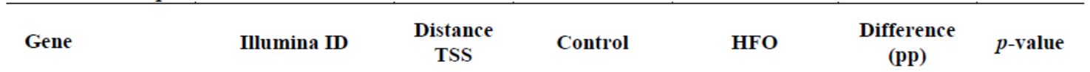
Methylation Changes
HFO minus Control

Slide 208
Pathway Analysis
Looking at the differently methylated regions, and the genes they associate with; what can this tell us about the biology?
Identification of genes and proteins associated with the etiology of a specific disease

Slide 209
Pathway Analysis

Slide 210
Gene Expression Changes
Candidate gene approach
  43 T2DM susceptibility genes
    Significant change in 24 genes following HFO
    Methylation changes present in >50% of the CpG sites on the array
  341 genes changed in the HFO-first group (2%)
  7673 genes change in the control-first group (45%)
    But note the heatmap
    66% of genes that changed with HFO diet had a methylation change in the opposite direction when switched back to control

Slide 211
Methylation→Gene Expression
Few changes observed in gene expression either in control diet first or HFO first
  DNMT3A and DNMT1 borderline incr. (P=0.08/0.10)
  Minor proportion of correlations between DNA methylation and gene expression; inconsistent

Slide 212
So what?
Short term high-fat overfeeding induces global DNA methylation changes that are only partly reversed after 6-8 weeks
Changes were broad, but small in magnitude
DNA methylation levels are plastic, and respond to dietary intervention in humans
What role does diet play in long-term DNA methylation?

Slide 213
Today’s objectives
Does diet cause disease?
Why study gene-diet interactions?
What do we mean by interaction?
Methodological approaches to studying gene-diet interaction
Public Health implications

Slide 214
What does the future hold?
23andme $99USD
  After four years of negotiations between the Food and Drug Administration and 23andMe, the FDA sent a warning letter to 23andMe in November 2013 asking the company to immediately discontinue marketing their health-related genetic tests. The FDA said 23andMe failed to provide evidence that their tests were "analytically or clinically validated." The warning letter was also prompted by 23andMe's alleged failure to communicate with the FDA for several months

Slide 215
What does the future hold?
Nutrgenomix (Toronto) $535
  Personalized nutrition program with initial consultation and meal plan

Slide 216


Slide 217
Potential Benefits
Keeps focus on diet
Increases awareness of certain conditions
Identify subgroups who may derive particular benefit from nutrition intervention
Help further our understanding of how diet works to affect disease susceptibility

Slide 218
Potential Harms
Approach has largely been single nutrient
  Overstate the importance of single nutrients
May decrease important emphasis on other lifestyle risk factors (e.g. smoking)
  80% of CHD can be prevented by lifestyle changes
We may act on false positive findings
Creating a “need” for designer foods, personalized medicine
Dilute (or contradict) public health messages

Slide 219
Summary

Slide 220
Summary
Human disease is complex; result from complex interactions between genetic and environmental factors
  Elucidating the contributions of each is important
Genetic variations are generally insufficient to cause complex disease; but influence risk
  Quantifying the contribution of genetics to risk is important

Slide 221
Summary
Characterizing gene-environment interactions provide opportunities for more effective prevention and management strategies
  Additional motivation to adhere to healthful diets
Much is still be understood about genetic and epigenetic factors, their mutual interactions, and their interaction with the environment
  Will this represent an important advancement?

Slide 222
Summary
Common study designs in epidemiology can help further our understanding of gene-diet interactions
  Cross-sectional studies (hypotheses)
  Case-control studies (associations)
  Case-cohort studies (more power)

Slide 223
Thank you!

